Slide 1
Operating a meteorological risk report map in a sovereign cloud with 3 classes of object storage S3 APIs and storage cloud services May 2023
Talk

Slide 2


Charlotte Letamentdia Product Manager Storage, OVHcloud
Laurent Song Product Owner Object Storage, OVHcloud

Slide 3
My data is my asset
As a dev.sec.ops I respect good practices and work in peace !
for me
I understand the value of my data assets
I am concerned by attacks and risks
I manage data with S3 API
My cloud provider takes care of the infrastructure for me.
Let’s share together the best practice in data security

Slide 4

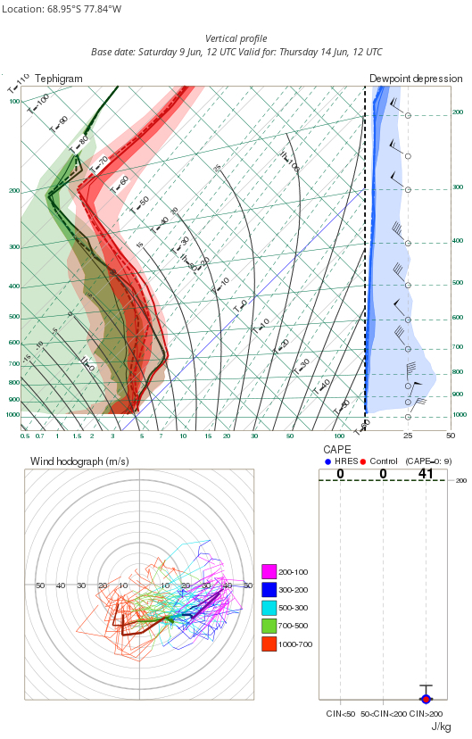
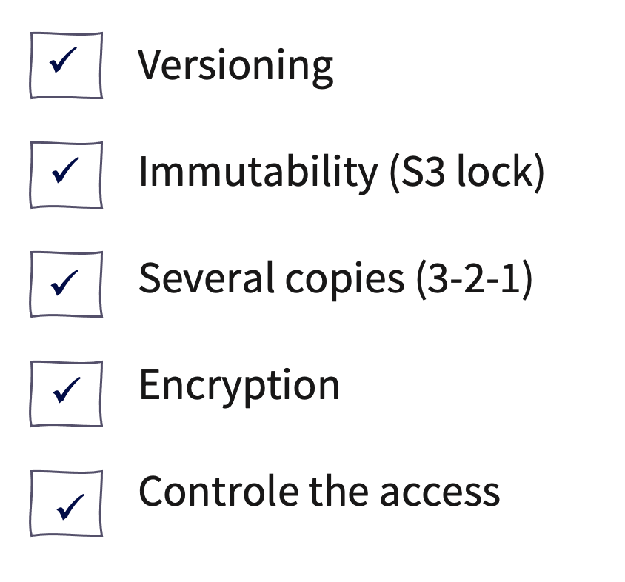
Website delivery – High availability and security
Data protection with S3 API
SENSITIVE REPORT
Risks
PROTECTION MEANS
Human errors
Deletion
Overwrite
Non predictables
Software issues, hardware issues, datacenter downtime, geographical disaster
Cyberattacks
Malware, ransomware & viruses, act of sabotage, DDoS

Slide 5
Rule n° 1 - versioning
aws s3api put-bucket-versioning --bucket mybackup –versioning-configuration Status=Enabled
Protection against accidental overwriting
Reversing after accidental delete
Fetch any version
Lifecycle to store not too long old versions

Slide 6



Rule n° 2 - immutability
aws s3api put-object-lock-configuration --bucket my_bucket --object-lock-configuration '{ "ObjectLockEnabled": "Enabled", "Rule": { "DefaultRetention": { "Mode": "GOVERNANCE", "Days": 10 }}}'
Primary storage systems must be open and available
Retention periods
Your backup data should be isolated and immutable
or legal hold
Governance mode
or compliance mode
Write Once, Read Many (WORM) model
S3 lock

Slide 7
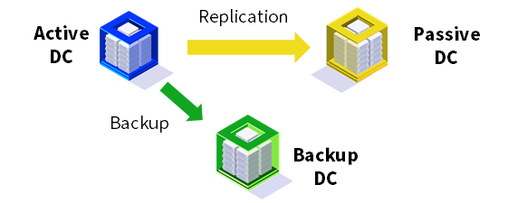
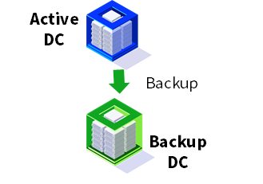
Rule n°3 - replication
aws s3api put-bucket-replication --bucket my-data --replication-configuration '{"Rules": [{"ID": "my-rule","Priority": 1,"Status": "Enabled","Destination": {"Bucket": "my-backup","StorageClass": "STANDARD"},"DeleteMarkerReplication": {"Status": "Enabled"}}]}'
Essential applications
RPO > 1h & RTO > 4h
Non-Critical Application
RPO > 24h & RTO > 24h
Retention policy
Non business critical | Weekly
Business critical | Every day during 1 month than monthly during 1 year
Archive | > 1 year
+ archive
+ archive
3 copies of data + 2 supports + 1 off site

Slide 8


Rule n°4 - encryption
aws s3api put-object \ --body /etc/my-object \ --bucket <bucket_name> \ --key encrypt_my-object \ --sse-customer-algorithm AES256 \ --sse-customer-key $encKey \ --sse-customer-key-md5 $md5Key
Encrypt your data
Encryption at rest
Encryption in transit
SSE-C : with customer key
Based on AES-256
Cli, Api with Https / TLS

Slide 9




Rule n°5 - user policies
{ "Statement":[{ "Sid":"ROContainer", "Effect":"Allow", "Action":["s3:GetObject","s3:ListBucket","s3:ListMultipartUploadParts","s3:ListBucketMultipartUploads"], "Resource":["arn:aws:s3:::hp-bucket","arn:aws:s3:::hp-bucket/*"] }] }
Grant only the permissions that are required to perform a task
User policy
Bucket policy
{ "Statement":[{ "Sid":"FullAccess", "Effect":"Allow", "Action":["s3:*"], "Resource":["*"] }] }

Slide 10

Best practice with 5 rules
Versioning
Immutability (S3 lock)
Several copies (3-2-1)
Encryption
Controle the access
Be uncompromising in the implementation of security compliance.

Slide 11
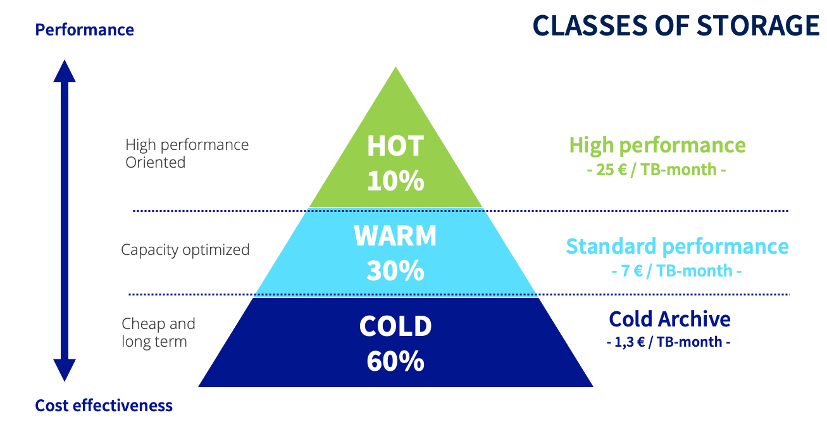
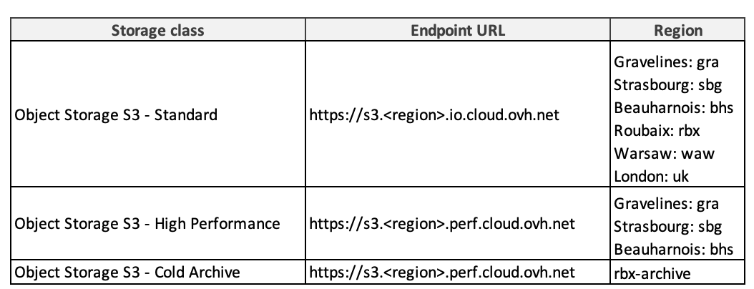
Website delivery – Storage classes
Tiering, putting the data in the right place in the right moment with S3 API
Credentials S3
(access key, secret key)
Project Public Cloud
(tenant, openstackID)
Endpoint

Slide 12

Website delivery – Sovereinghty
A trusted cloud
Confidentiality requirements
Data security
Transparency
Protection tools
Strong operational relationships with security communities
Transparency
Reversibility
Not subject to extraterritorial laws
Operation in compliance with the GDPR

Slide 13
Let me show you my use case!

Slide 14
Demonstration

Slide 15

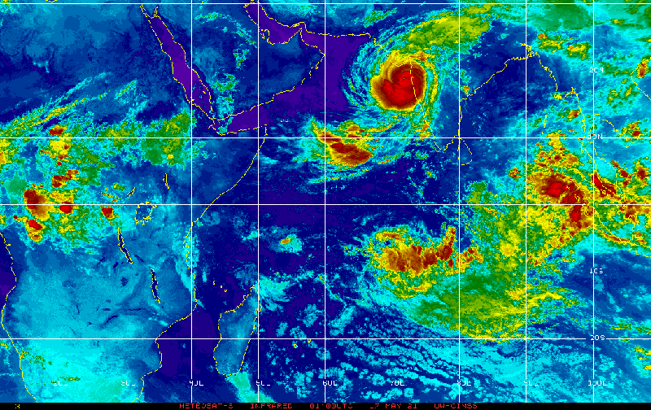
Use case: meteorological risks report generation app

Slide 16



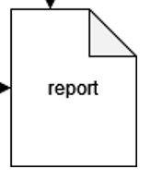
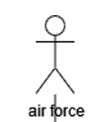




Workflow
data lifecycle in 5 steps
METEO
GRIB
FILE
Acquisition
Storage
Processing consumption
Disposal
Back up and archive
Object Storage class
High Performance
RW ++++
Object Storage class
Standard
Capacitive
Block/file storage
R/W ++++++++
Object Storage class
High Performance
RW ++++
Object Storage class Standard
Capacitive
Archive
Cold

Slide 17
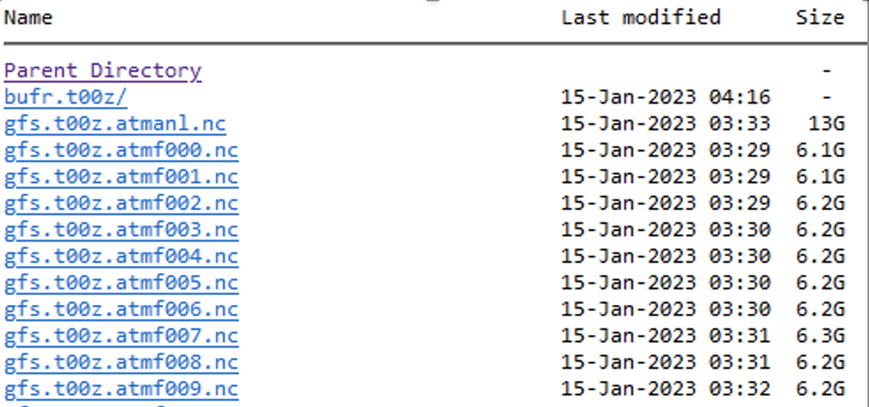
Input data
forecast model runtimes
D-1
D
06:00 pm runtime
12:00 am runtime
06:00 am runtime
12:00 pm runtime
06:00 pm runtime
12:00 am runtime
Grib files dowload
Grib files dowload
IO intensive!

Slide 18
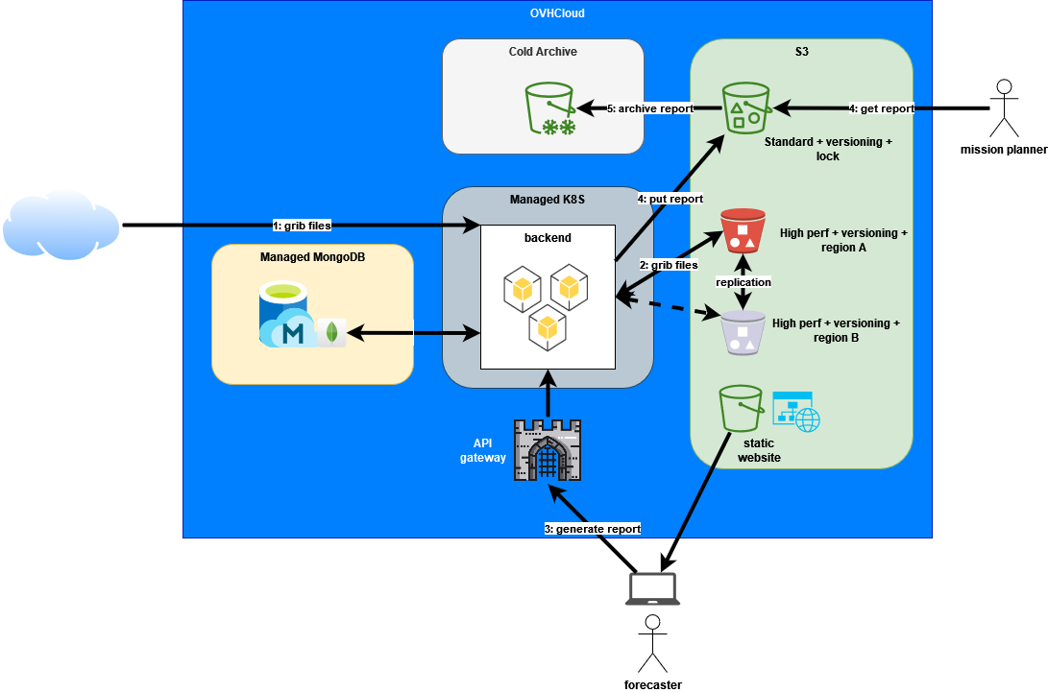
Bird's-eye view of architecture

Slide 19



Find us online
Charlotte.letamendia
laurentsong
https://docs.ovh.com/us/en/storage/
https://github.com/ovh/public-cloud-roadmap

